Slide 1


Slide 2
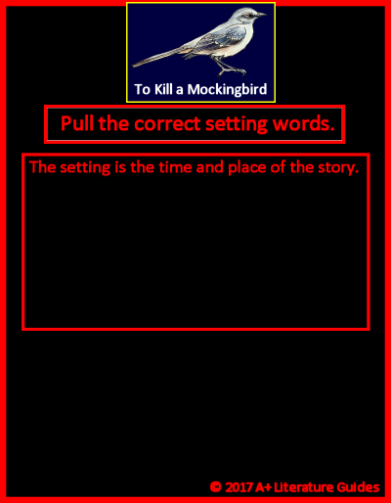









Drag and drop (into the center area) the words that correctly identify the novel’s setting.

Slide 3
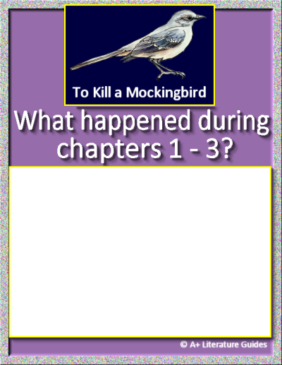
For each chapter, record:
Chapter’s setting
Main events
One of the following:
Character actions, relationships, traits
Internal/external conflicts/challenges, solutions/resolutions
Themes, messages
Questions, predictions
Mood, tone
Chapter 1
Insert text
Insert text
Insert text
Insert text
Chapter 2
Insert text
Insert text
Insert text
Insert text
Chapter 3
Insert text
Insert text
Insert text
Insert text
Insert text

Slide 4
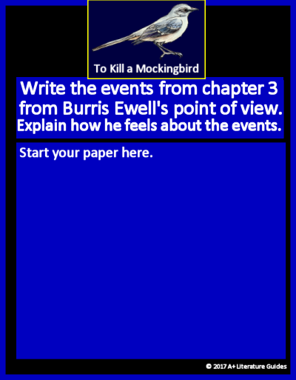
Discuss at least three of the following (and then discuss how Burris likely feels).
His appearance
His hygiene
The language he uses toward the teacher
His classmates’ reactions toward Burris or Miss Caroline
His departure from the classroom
From Burris Ewell’s point of view, here is a reimagining of the events of Chapter 3:
Insert text
Insert text
Insert text
As a result, Burris likely feels:
Insert text

Slide 5
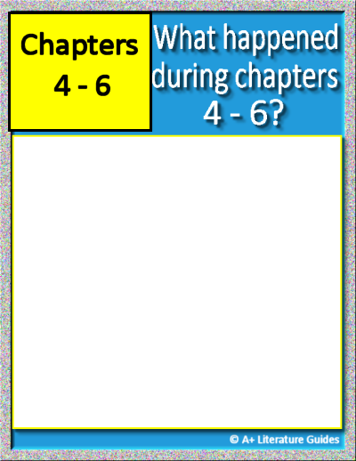
Chapter 4
Insert text
Insert text
Insert text
Insert text
Insert text
Chapter 5
Insert text
Insert text
Insert text
Insert text
Insert text
Chapter 6
Insert text
Insert text
Insert text
Insert text
Insert text
For each chapter, record:
Chapter’s setting
Main events
One of the following:
Character actions, relationships, traits
Internal/external conflicts/challenges, solutions/resolutions
Themes, messages
Questions, predictions
Mood, tone

Slide 6

Character Trait Word Bank
Absent-minded
Aggressive
Ambitious
Boastful
Bold
Bossy
Brave
Calm
Careful
Caring
Compassionate
Compliant
Creative
Cruel
Curious
Determined
Distrustful
Dreamy
Empathetic
Energetic
Fair
Focused
Friendly
Hardworking
Helpful
Honest
Humble
Imaginative
Independent
Jealous
Kind
Lazy
Loud
Loyal
Mature
Mean
Mysterious
Nosy
Nurturing
Observant
Overconfident
Patient
Persistent
Polite
Principled
Protective
Pushy
Quiet
Reckless
Reflective
Reserved
Resilient
Responsible
Rude
Selfish
Serious
Shy
Simple
Smart
Sneaky
Stubborn
Thoughtful
Thoughtless
Trustworthy
Understanding
Watchful
Withdrawn
Insert text
Insert text
Insert text
Insert text
Insert text
Insert text
Insert text
Insert text
Insert text
Insert text

Slide 7
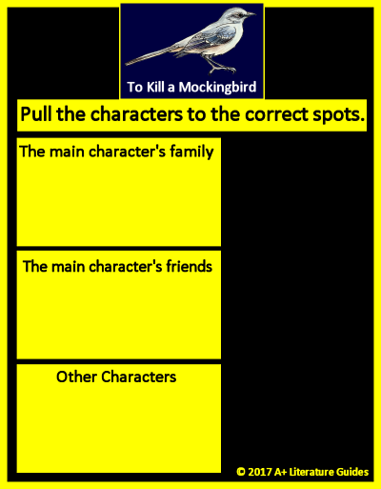










Drag and drop each character into the correct area.

Slide 8
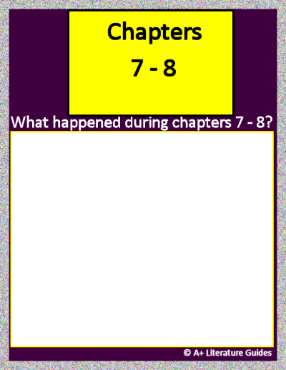
Chapter 7
Insert text
Insert text
Insert text
Insert text
Insert text
Chapter 8
Insert text
Insert text
Insert text
Insert text
Insert text
For each chapter, record:
Chapter’s setting
Main events
One of the following:
Character actions, relationships, traits
Internal/external conflicts/challenges, solutions/resolutions
Themes, messages
Questions, predictions
Mood, tone

Slide 9
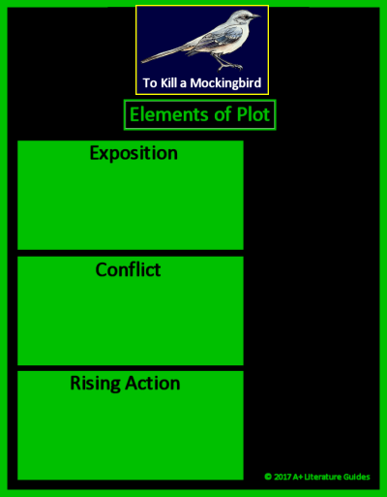






Drag and drop each plot element into the appropriate area.

Slide 10
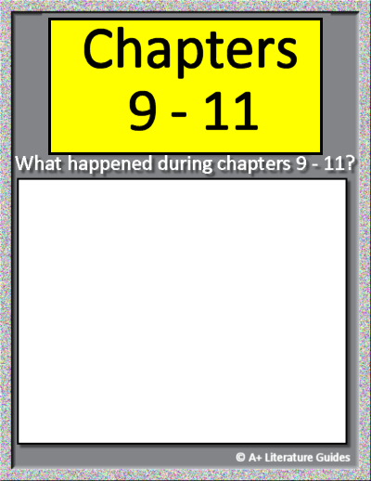
Chapter 9
Insert text
Insert text
Insert text
Insert text
Insert text
Chapter 10
Insert text
Insert text
Insert text
Insert text
Insert text
Chapter 11
Insert text
Insert text
Insert text
Insert text
Insert text
For each chapter, record:
Chapter’s setting
Main events
One of the following:
Character actions, relationships, traits
Internal/external conflicts/challenges, solutions/resolutions
Themes, messages
Questions, predictions
Mood, tone

Slide 11
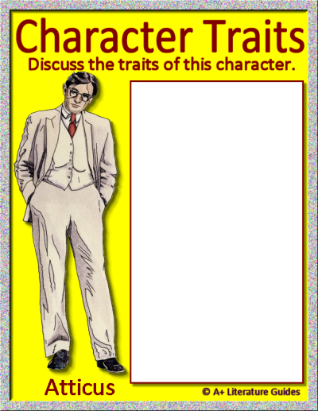
Character Trait Word Bank
Absent-minded
Aggressive
Ambitious
Boastful
Bold
Bossy
Brave
Calm
Careful
Caring
Compassionate
Compliant
Creative
Cruel
Curious
Determined
Distrustful
Dreamy
Empathetic
Energetic
Fair
Focused
Friendly
Hardworking
Helpful
Honest
Humble
Imaginative
Independent
Jealous
Kind
Lazy
Loud
Loyal
Mature
Mean
Mysterious
Nosy
Nurturing
Observant
Overconfident
Patient
Persistent
Polite
Principled
Protective
Pushy
Quiet
Reckless
Reflective
Reserved
Resilient
Responsible
Rude
Selfish
Serious
Shy
Simple
Smart
Sneaky
Stubborn
Thoughtful
Thoughtless
Trustworthy
Understanding
Watchful
Withdrawn
Insert text
Insert text
Insert text
Insert text
Insert text
Insert text
Insert text
Insert text
Insert text
Insert text

Slide 12
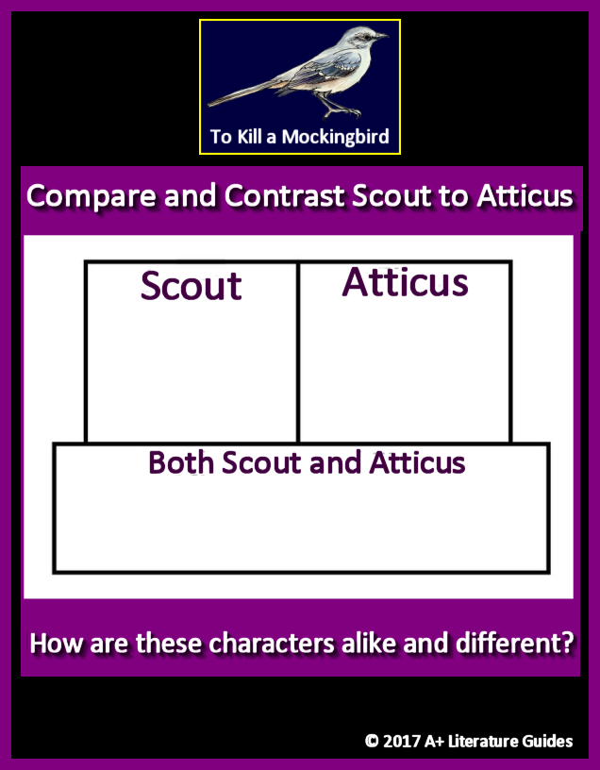
Character Trait Word Bank
Absent-minded
Aggressive
Ambitious
Boastful
Bold
Bossy
Brave
Calm
Careful
Caring
Compassionate
Compliant
Creative
Cruel
Curious
Determined
Distrustful
Dreamy
Empathetic
Energetic
Fair
Focused
Friendly
Hardworking
Helpful
Honest
Humble
Imaginative
Independent
Jealous
Kind
Lazy
Loud
Loyal
Mature
Mean
Mysterious
Nosy
Nurturing
Observant
Overconfident
Patient
Persistent
Polite
Principled
Protective
Pushy
Quiet
Reckless
Reflective
Reserved
Resilient
Responsible
Rude
Selfish
Serious
Shy
Simple
Smart
Sneaky
Stubborn
Thoughtful
Thoughtless
Trustworthy
Understanding
Watchful
Withdrawn
Insert text
Insert text
Insert text
Insert text
Insert text
Insert text
Insert text
Insert text
Insert text

Slide 13
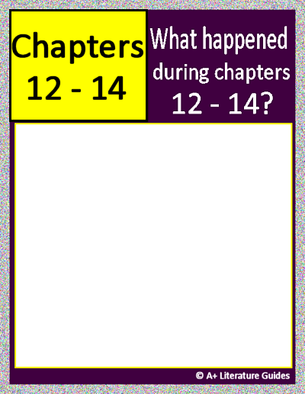
Chapter 12
Insert text
Insert text
Insert text
Insert text
Insert text
Chapter 13
Insert text
Insert text
Insert text
Insert text
Insert text
Chapter 14
Insert text
Insert text
Insert text
Insert text
Insert text
For each chapter, record:
Chapter’s setting
Main events
One of the following:
Character actions, relationships, traits
Internal/external conflicts/challenges, solutions/resolutions
Themes, messages
Questions, predictions
Mood, tone

Slide 14

Character Trait Word Bank
Absent-minded
Aggressive
Ambitious
Boastful
Bold
Bossy
Brave
Calm
Careful
Caring
Compassionate
Compliant
Creative
Cruel
Curious
Determined
Distrustful
Dreamy
Empathetic
Energetic
Fair
Focused
Friendly
Hardworking
Helpful
Honest
Humble
Imaginative
Independent
Jealous
Kind
Lazy
Loud
Loyal
Mature
Mean
Mysterious
Nosy
Nurturing
Observant
Overconfident
Patient
Persistent
Polite
Principled
Protective
Pushy
Quiet
Reckless
Reflective
Reserved
Resilient
Responsible
Rude
Selfish
Serious
Shy
Simple
Smart
Sneaky
Stubborn
Thoughtful
Thoughtless
Trustworthy
Understanding
Watchful
Withdrawn
Insert text
Insert text
Insert text
Insert text
Insert text
Insert text
Insert text
Insert text
Insert text
Insert text

Slide 15
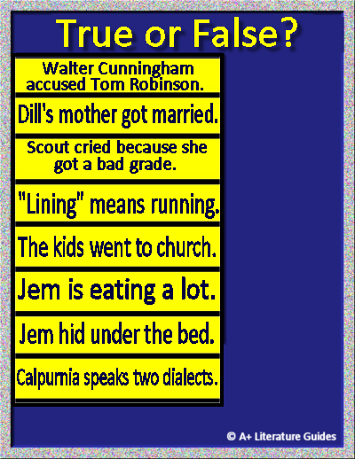


Drag and drop each option to correctly identify which statements are true or false.

Slide 16
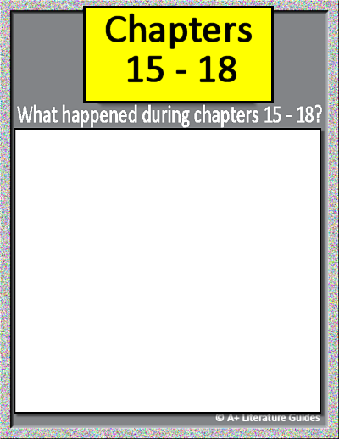
Chapter 15
Insert text
Insert text
Insert text
Insert text
Insert text
Chapter 16
Insert text
Insert text
Insert text
Insert text
Insert text
Chapter 17
Insert text
Insert text
Insert text
Insert text
Insert text
Chapter 18
Insert text
Insert text
Insert text
Insert text
Insert text
For each chapter, record:
Chapter’s setting
Main events
One of the following:
Character actions, relationships, traits
Internal/external conflicts/challenges, solutions/resolutions
Themes, messages
Questions, predictions
Mood, tone

Slide 17
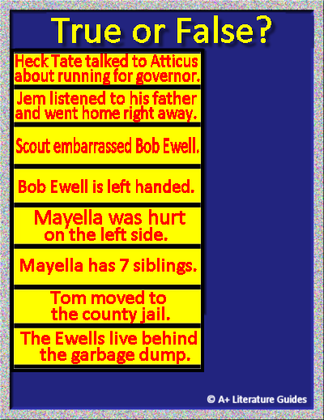
Drag and drop each option to correctly identify which statements are true or false.

Slide 18
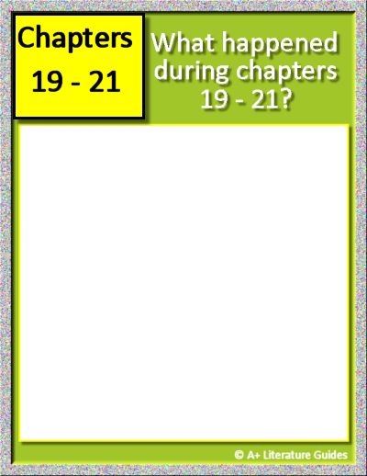
Chapter 19
Insert text
Insert text
Insert text
Insert text
Insert text
Chapter 20
Insert text
Insert text
Insert text
Insert text
Insert text
Chapter 21
Insert text
Insert text
Insert text
Insert text
Insert text
Click and type here.
For each chapter, record:
Chapter’s setting
Main events
One of the following:
Character actions, relationships, traits
Internal/external conflicts/challenges, solutions/resolutions
Themes, messages
Questions, predictions
Mood, tone

Slide 19
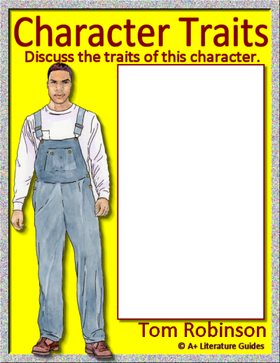
Character Trait Word Bank
Absent-minded
Aggressive
Ambitious
Boastful
Bold
Bossy
Brave
Calm
Careful
Caring
Compassionate
Compliant
Creative
Cruel
Curious
Determined
Distrustful
Dreamy
Empathetic
Energetic
Fair
Focused
Friendly
Hardworking
Helpful
Honest
Humble
Imaginative
Independent
Jealous
Kind
Lazy
Loud
Loyal
Mature
Mean
Mysterious
Nosy
Nurturing
Observant
Overconfident
Patient
Persistent
Polite
Principled
Protective
Pushy
Quiet
Reckless
Reflective
Reserved
Resilient
Responsible
Rude
Selfish
Serious
Shy
Simple
Smart
Sneaky
Stubborn
Thoughtful
Thoughtless
Trustworthy
Understanding
Watchful
Withdrawn
Insert text
Insert text
Insert text
Insert text
Insert text
Insert text
Insert text
Insert text
Insert text
Insert text

Slide 20
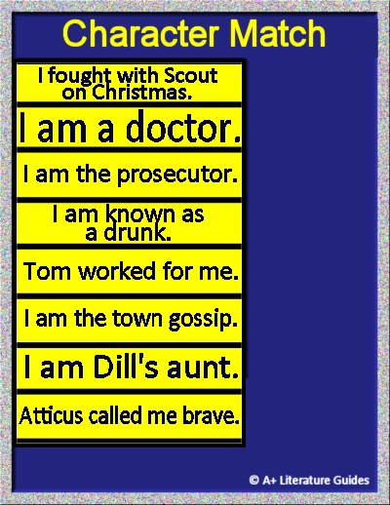








Drag and drop each character to correctly match the statements.

Slide 21

Chapter 22
Insert text
Insert text
Insert text
Insert text
Insert text
Chapter 23
Insert text
Insert text
Insert text
Insert text
Insert text
Chapter 24
Insert text
Insert text
Insert text
Insert text
Insert text
For each chapter, record:
Chapter’s setting
Main events
One of the following:
Character actions, relationships, traits
Internal/external conflicts/challenges, solutions/resolutions
Themes, messages
Questions, predictions
Mood, tone

Slide 22
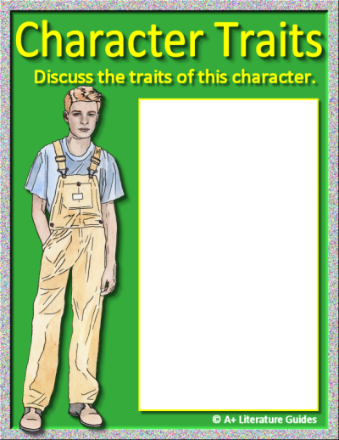
Character Trait Word Bank
Absent-minded
Aggressive
Ambitious
Boastful
Bold
Bossy
Brave
Calm
Careful
Caring
Compassionate
Compliant
Creative
Cruel
Curious
Determined
Distrustful
Dreamy
Empathetic
Energetic
Fair
Focused
Friendly
Hardworking
Helpful
Honest
Humble
Imaginative
Independent
Jealous
Kind
Lazy
Loud
Loyal
Mature
Mean
Mysterious
Nosy
Nurturing
Observant
Overconfident
Patient
Persistent
Polite
Principled
Protective
Pushy
Quiet
Reckless
Reflective
Reserved
Resilient
Responsible
Rude
Selfish
Serious
Shy
Simple
Smart
Sneaky
Stubborn
Thoughtful
Thoughtless
Trustworthy
Understanding
Watchful
Withdrawn
Insert text
Insert text
Insert text
Insert text
Insert text
Insert text
Insert text
Insert text
Insert text
Insert text
Jem

Slide 23
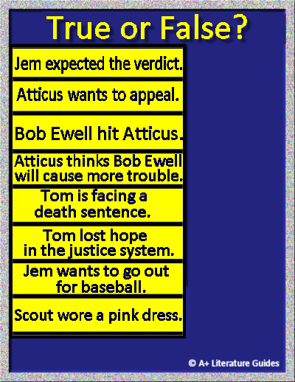
Drag and drop each option to correctly identify which statements are true or false.

Slide 24
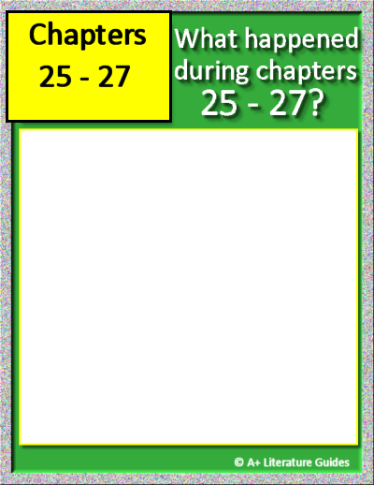
Chapter 25
Insert text
Insert text
Insert text
Insert text
Insert text
Chapter 26
Insert text
Insert text
Insert text
Insert text
Insert text
Chapter 27
Insert text
Insert text
Insert text
Insert text
Insert text
For each chapter, record:
Chapter’s setting
Main events
One of the following:
Character actions, relationships, traits
Internal/external conflicts/challenges, solutions/resolutions
Themes, messages
Questions, predictions
Mood, tone

Slide 25
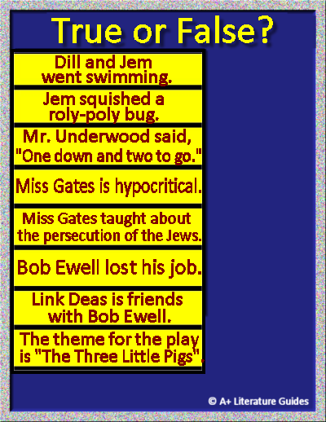
Drag and drop each option to correctly identify which statements are true or false.

Slide 26
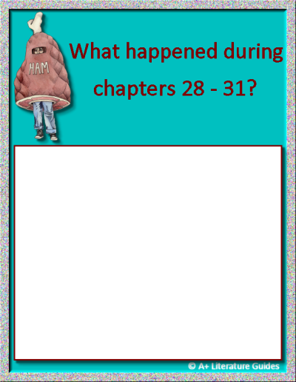
Chapter 28
Insert text
Insert text
Insert text
Insert text
Insert text
Chapter 29
Insert text
Insert text
Insert text
Insert text
Insert text
Chapter 30
Insert text
Insert text
Insert text
Insert text
Insert text
Chapter 31
Insert text
Insert text
Insert text
Insert text
Insert text
For each chapter, record:
Chapter’s setting
Main events
One of the following:
Character actions, relationships, traits
Internal/external conflicts/challenges, solutions/resolutions
Themes, messages
Questions, predictions
Mood, tone

Slide 27
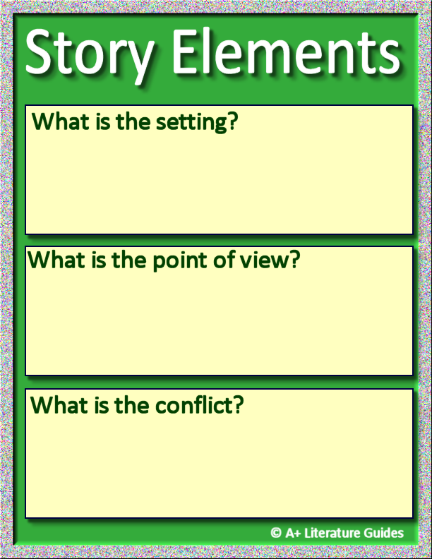
Insert text.
Insert text.
Insert text.

Slide 28
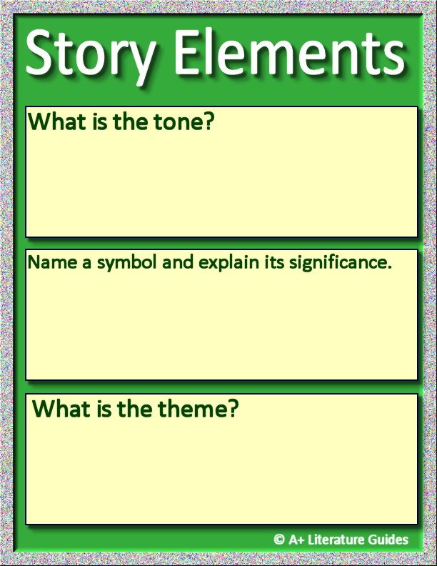
Insert text.
Insert text.
Insert text.

Slide 29
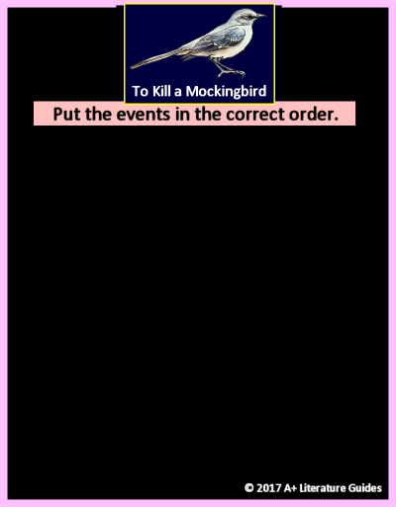





Drag and drop each event to place them in the correct order.

Slide 30
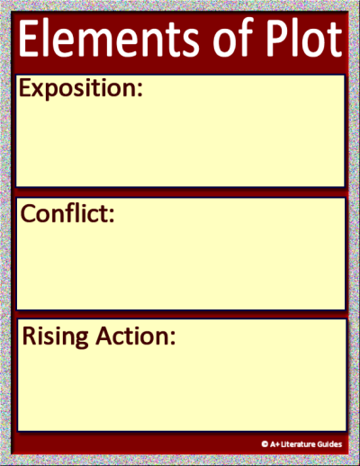
Plot Diagram: Novel
Insert text.
Insert text.
Insert text.

Slide 31
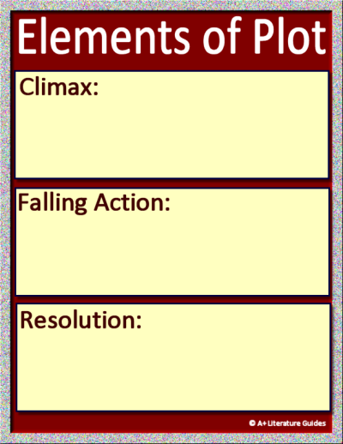
Plot Diagram: Novel
Insert text.
Insert text.
Insert text.

Slide 32
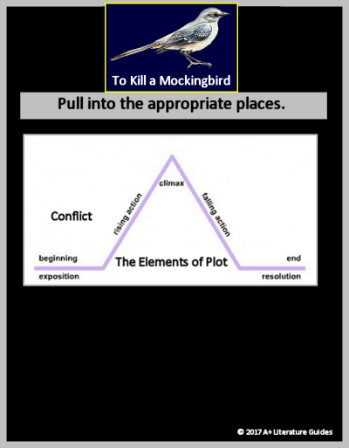






Plot Diagram: Scout
Drag and drop each event to the correct place on the plot diagram.

